Slide 1
A Book, a Web Browser and a Tablet: How Bibliotheca Alexandrina’ s Viewer Framework Makes it Possible
Engy Ali
The Library of Alexandria, Egypt

Slide 2
What we will cover…..
Goals …
Why not PDF…?!
Book Viewer framework
Future work

Slide 3
Goals…
Multiple digitization projects for preserving knowledge in monographs and availing them to people around the world
Readers miss features they like in old books.
Availability of e-readers, mobile phones …etc

Slide 4
PDF..why not!?
Copyright/Page selection
Morphological Search
All in One (Metadata, Content and Search) Object
Streaming/Browser Compatibility
Personalization/Annotation

Slide 5
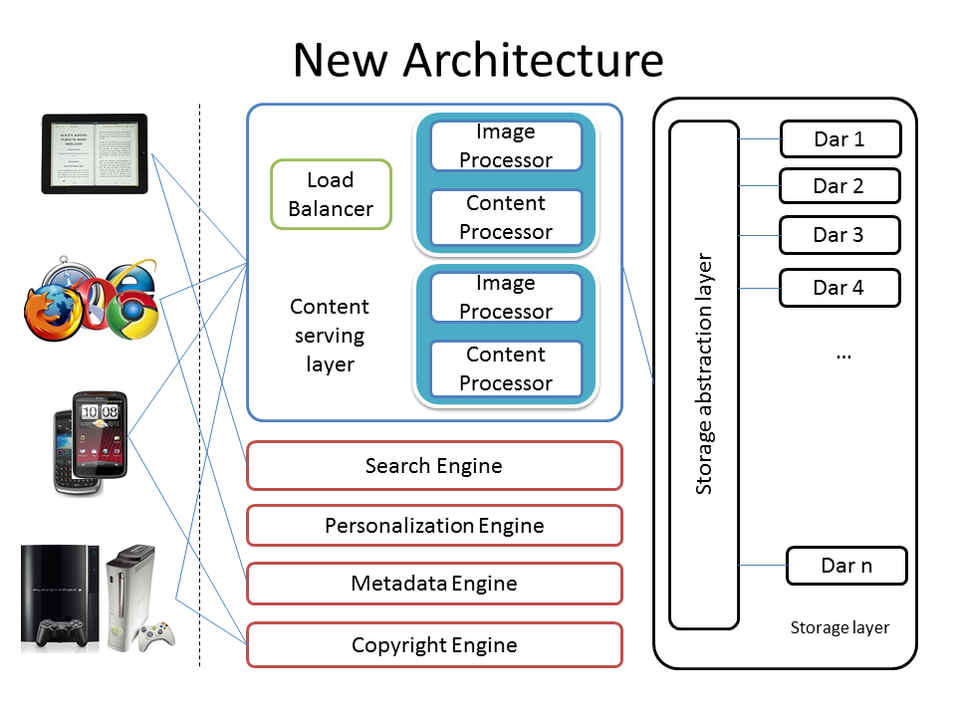
Book Viewer Framework
Client side
Server side

Slide 6
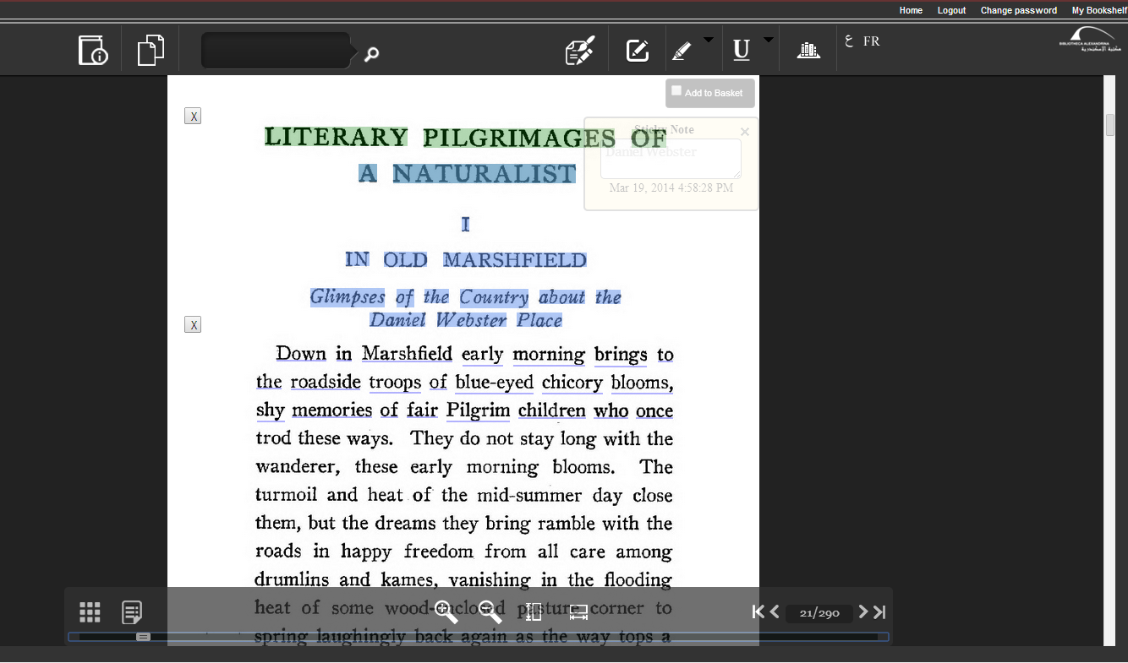
Client Side
Sticky Notes
Highlight
Underline

Slide 7
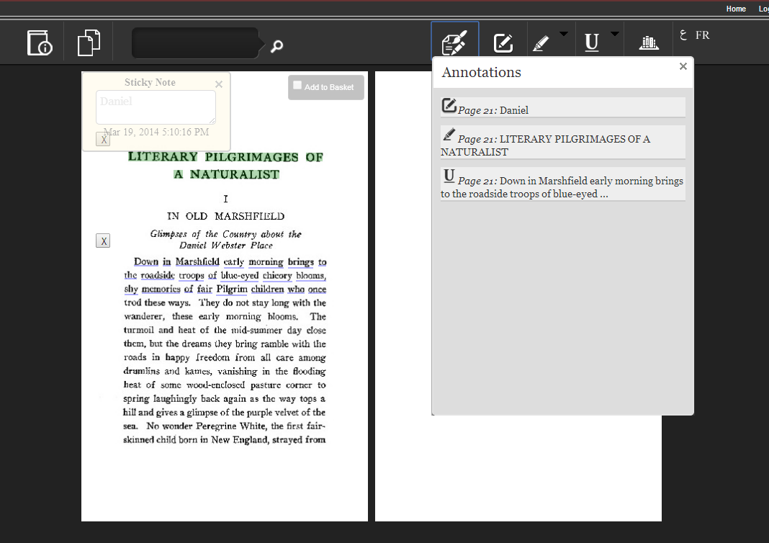
Annotations

Slide 8
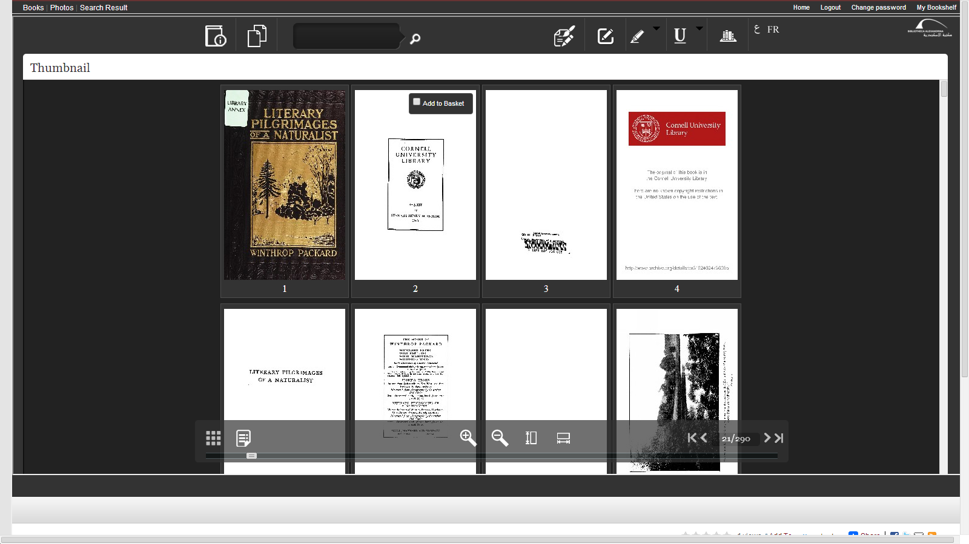
Thumbnail view and My Basket
Add to basket

Slide 9
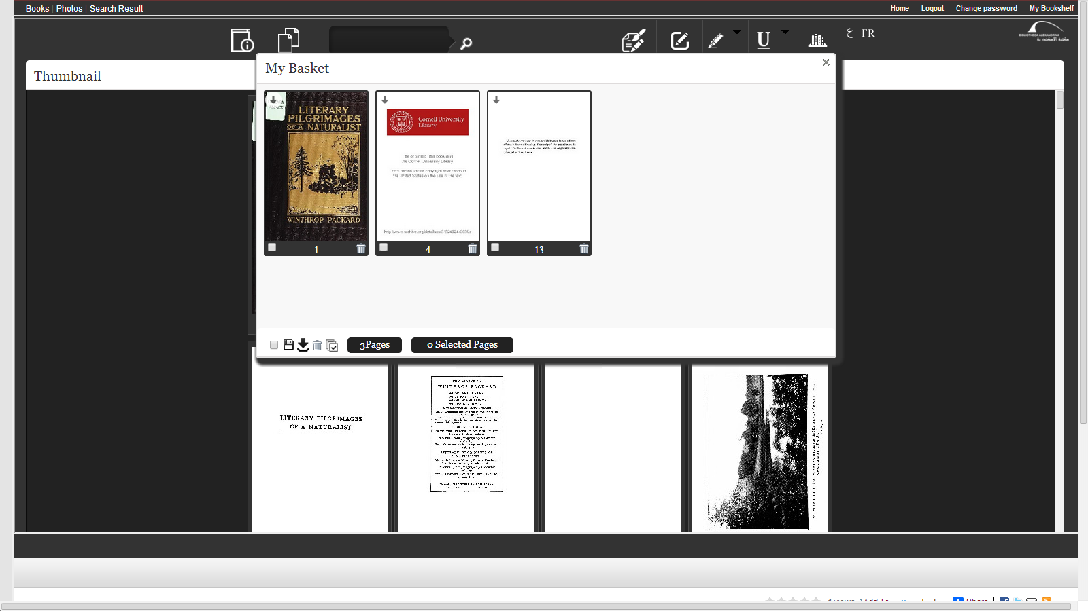
My Basket
- Download
- Save
- Delete

Slide 10
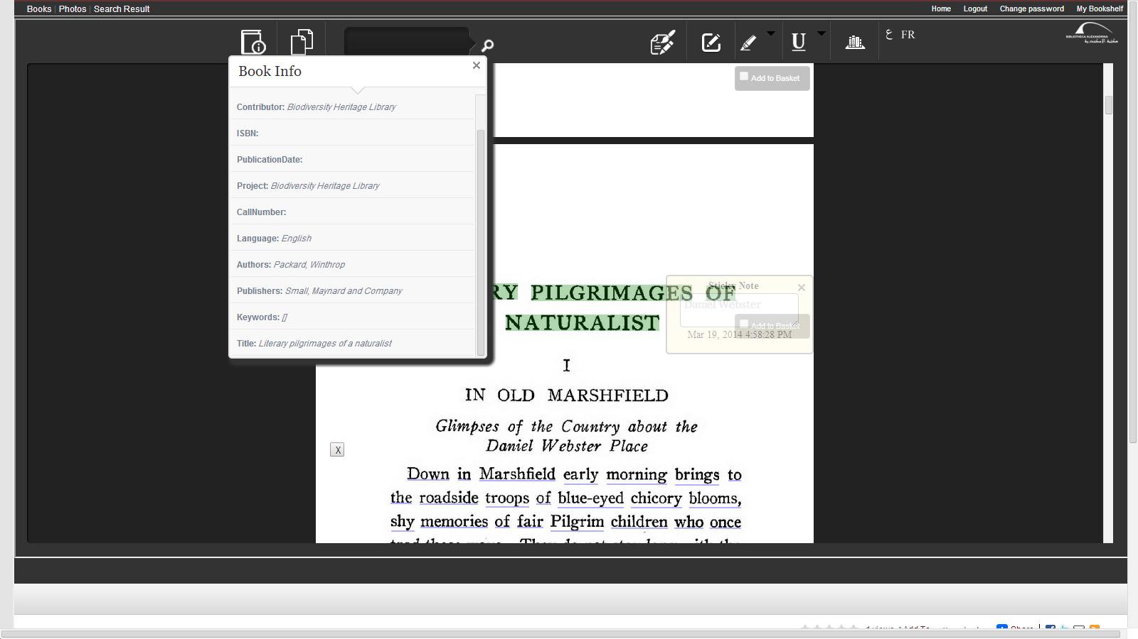
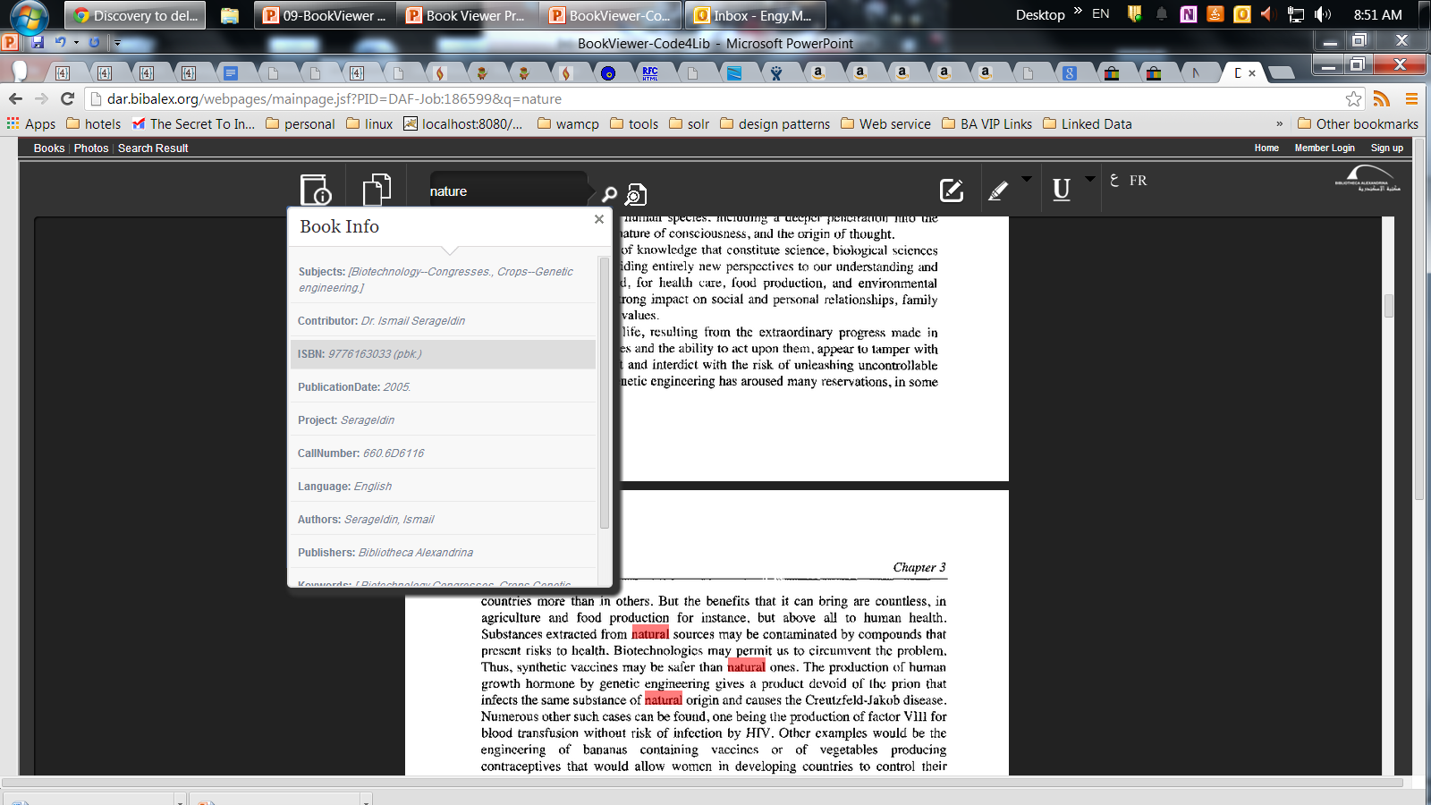
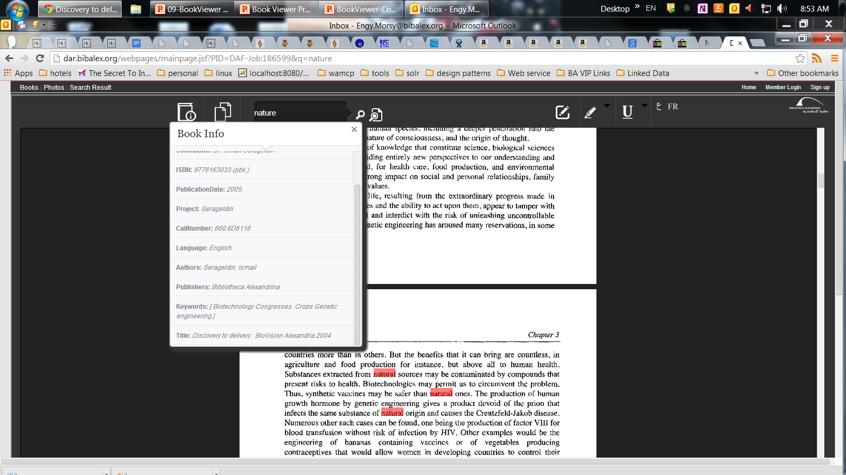
Metadata

Slide 11
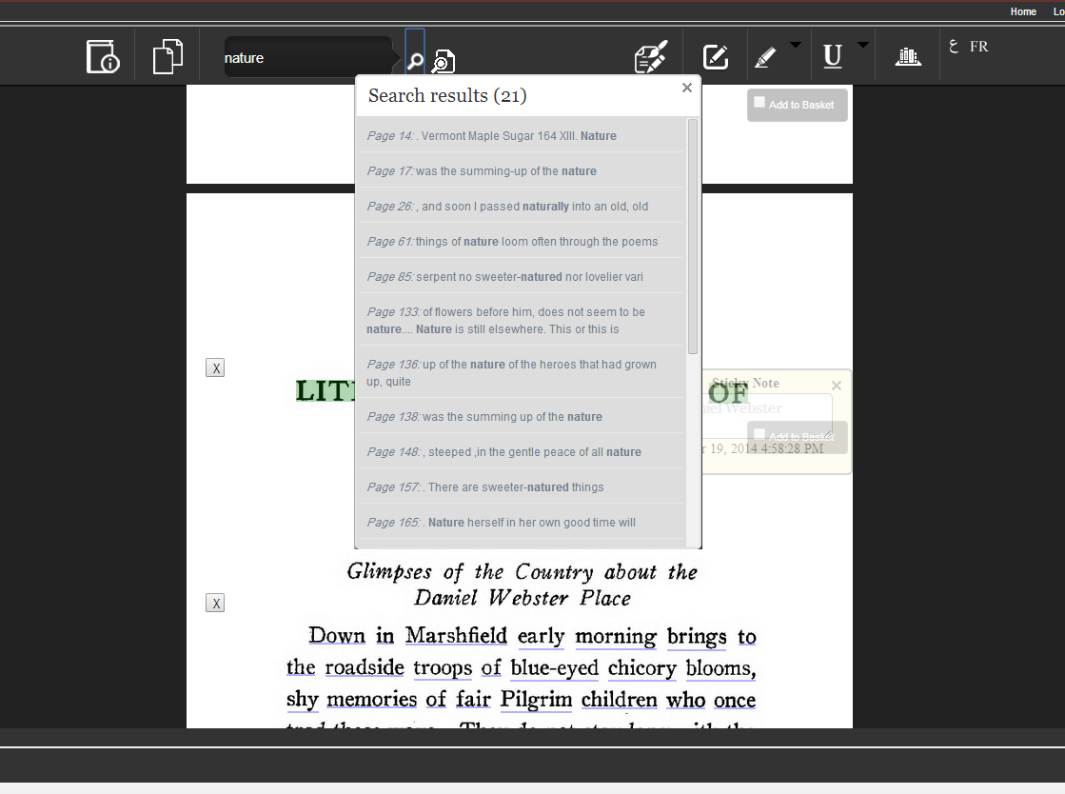
Searching

Slide 12
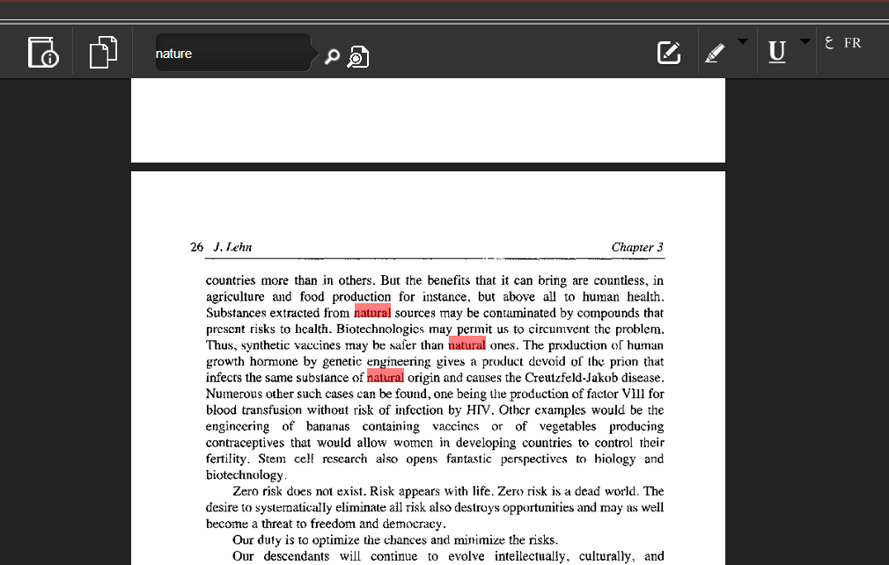
Search highlights

Slide 13
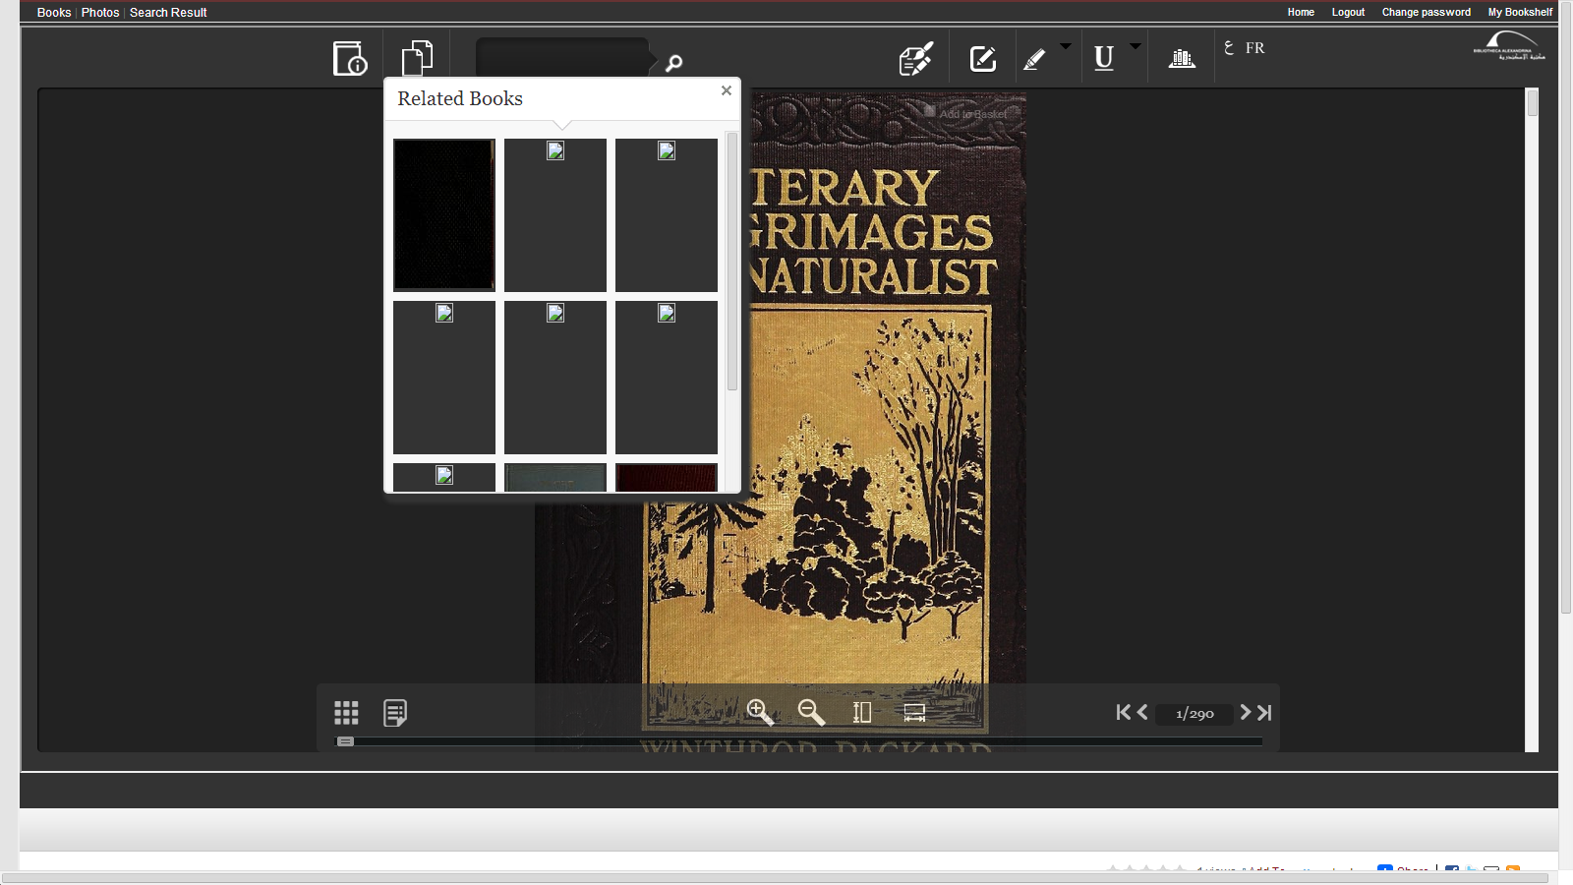
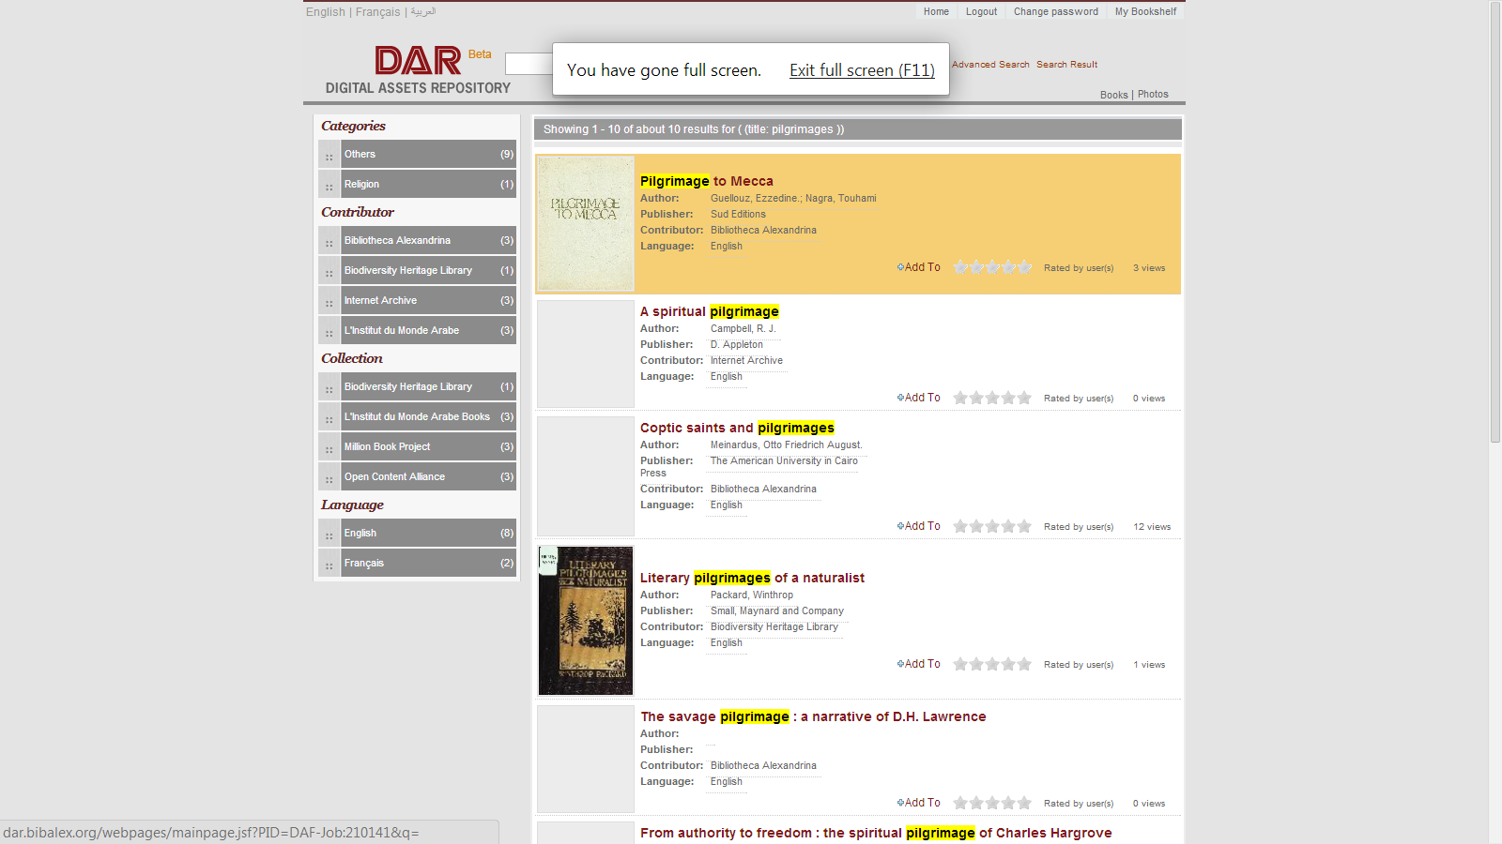
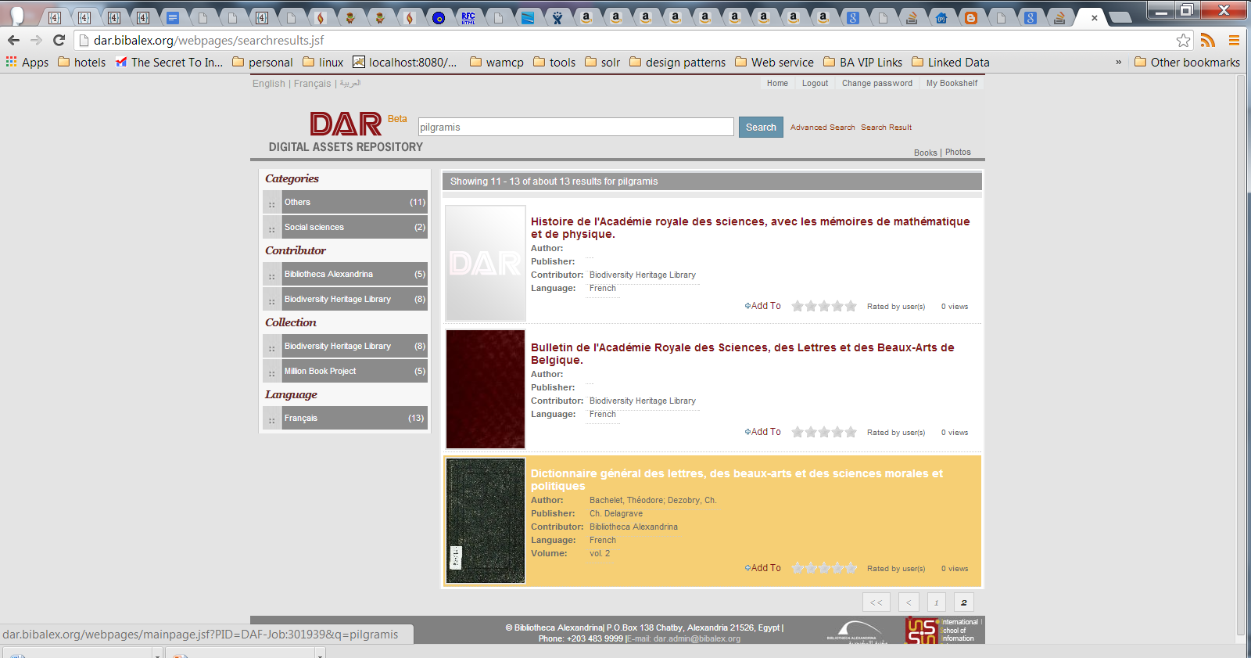
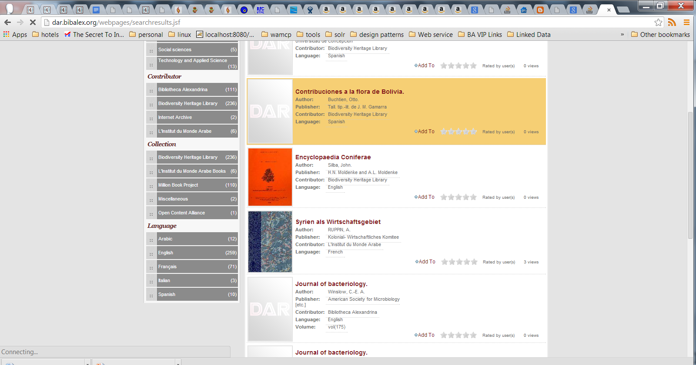
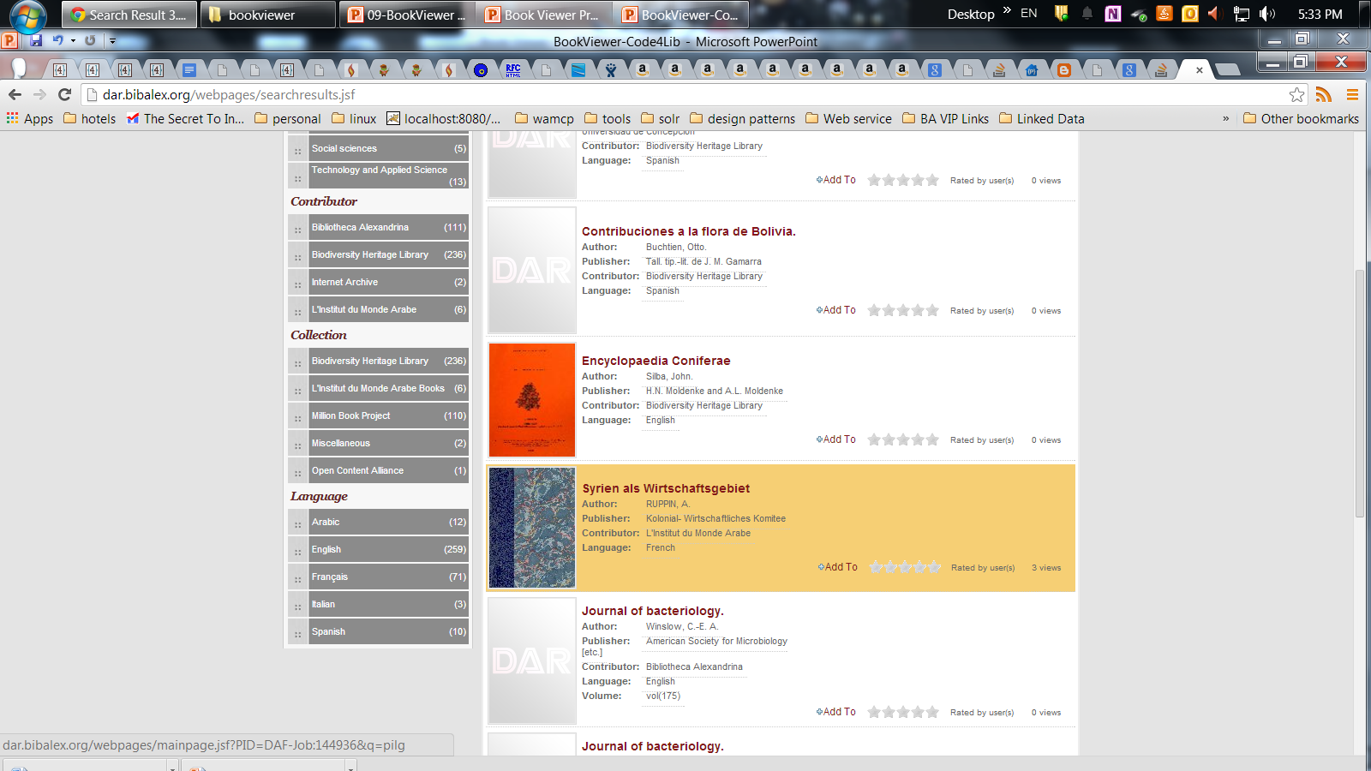
Related Books

Slide 14
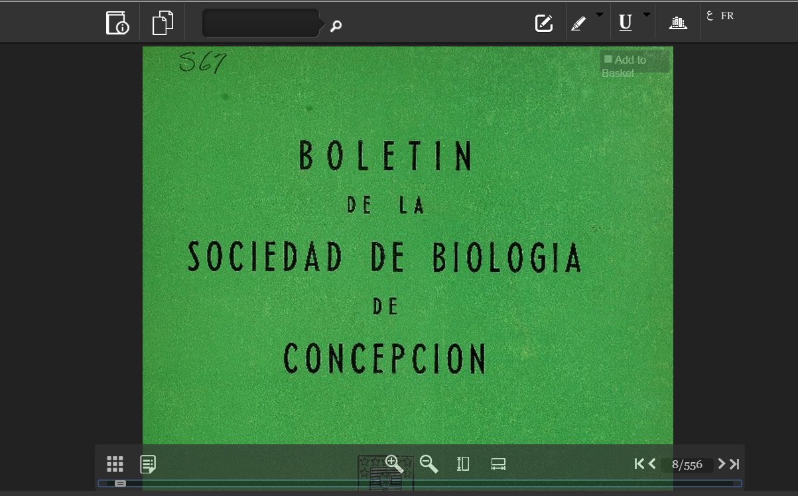
Zoom in

Slide 15
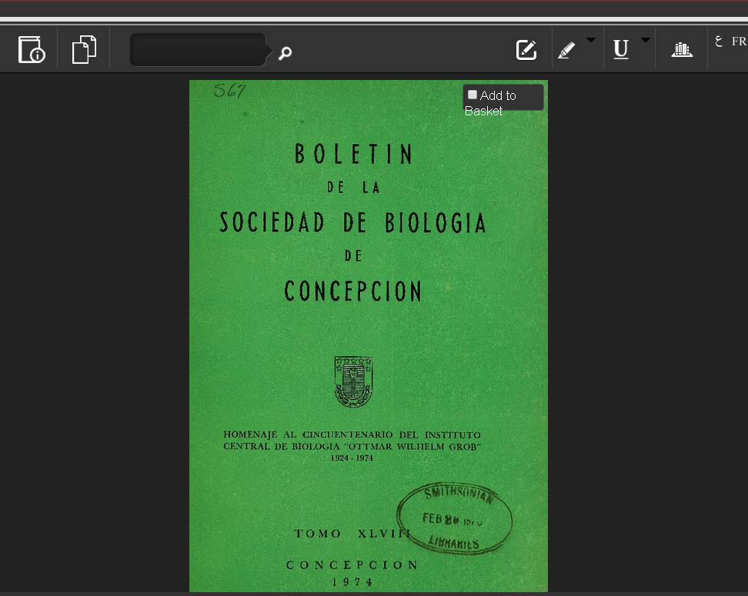
Zoom out

Slide 16

Server Side

Slide 17
Future work
Enhancing storage layer to ensure scalability and performance
Extend to include other type of media objects
Android mobile and tablet implementation are under progress

Slide 18
Thank you
Contact info:
engy.morsy@bibalex.org
http://dar.bibalex.org
Thanks for development team:
Mohamed Abuouda
Ahmed Omar

